Slide 1

Technical Presentation 3
Creating Report and Publishing on Power BI Service

Slide 2

Power BI
Three elements :
Power BI Desktop —to create
Power BI service —to share,
Power BI mobile apps —to consume business insights.
Power BI is a collection of software services, apps, and connectors that work together to help you create, share, and consume business insights in the way that serves you and your business most effectively.

Slide 3
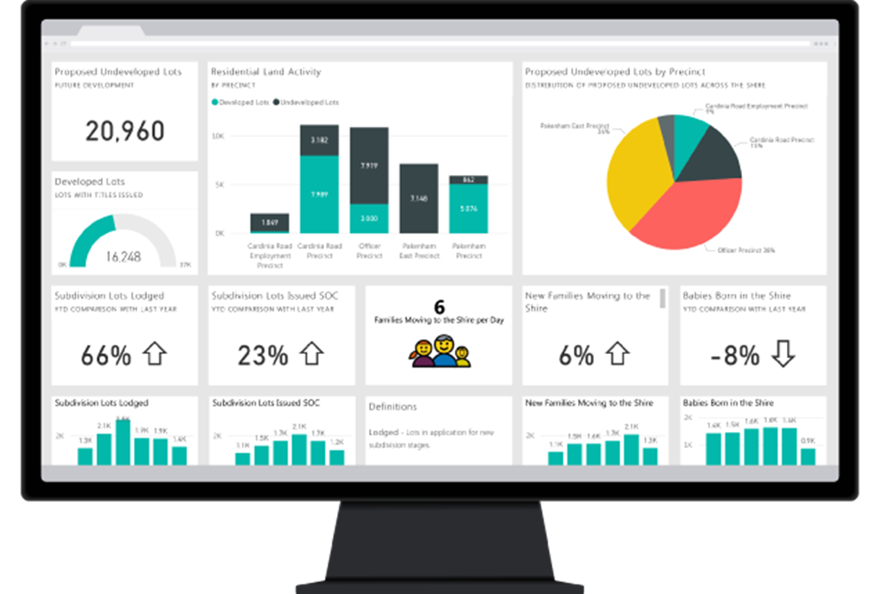
Power BI Service
The Microsoft Power BI service (https://app.powerbi.com), sometimes referred to as Power BI online, is the software as a service (SaaS) part of Power BI.
Dashboards and reports connect to datasets that bring all of the relevant data together in one place.

Slide 4

Creating Reports In Power BI Desktop
First add the data in Power BI Desktop
Create few visuals based on the given data.
Visuals like – Bar chart, Column chart, Pie chart, Donut chart, Card, Slicer, etc.
We can add From More visuals also.

Slide 5
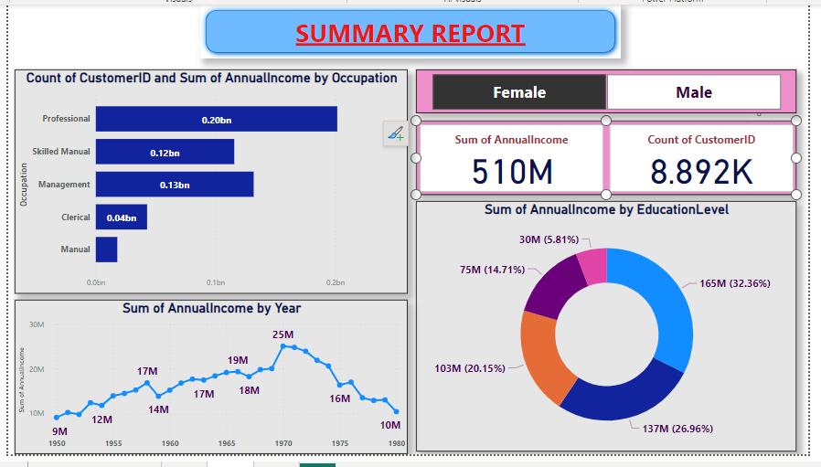

Slide 6
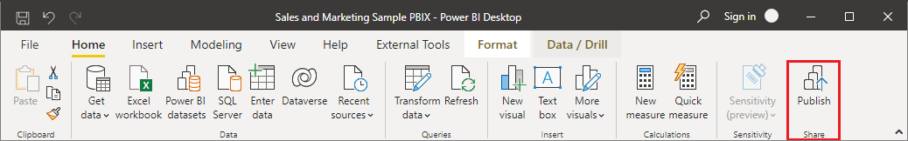
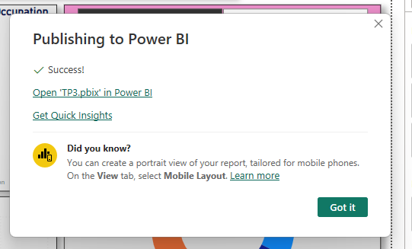
Publishing Online
First save report by your name
Sign in to Power BI if you aren't already signed in.
Home →Publish → My Workspace → Select.
When publishing is complete, you receive a link to your report. Select the link to open the report in your Power BI site or Login to “app.powerbi.com”.

Slide 7
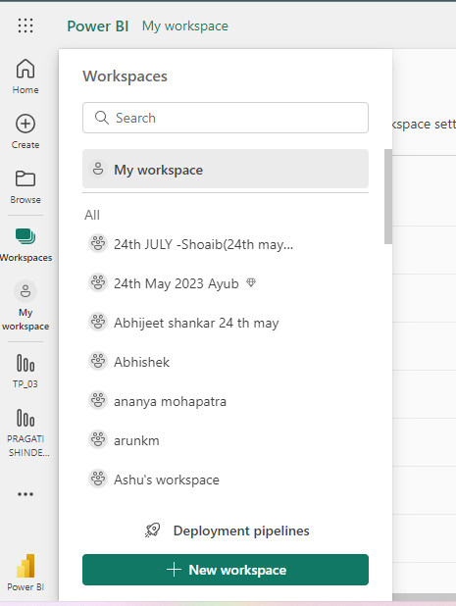
Creating own workspace: Select workspace → New Workspace → Give Your name → Click on apply.

Slide 8
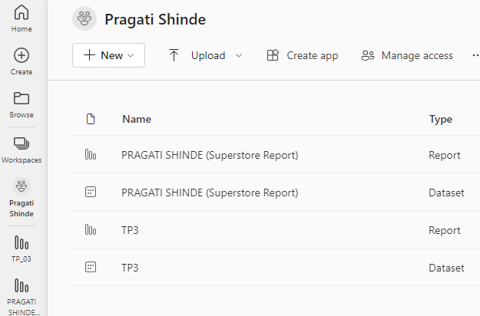
Uploading report: search workspace as your name → Click on Upload→ Browse → Select Report → Open.
It will uploaded your Report, Dataset and Dashboard .

Slide 9

Creating Reports In Power BI Service
We can also create Reports in Power BI services.
Creating Report:
Open Power BI Service → Get some data → Open it in Report View → Create visualization → Save as Report.

Slide 10

Thank You
BY - PRAGATI SHINDE

